Slide 1
Infrastructure Mock-up Portfolio Analysis: Cost, Delivery & Satisfaction Mott MacDonald – Graduate Application Portfolio Prepared by: Ishak Ahmed Date: November 2025 Tools Used: SQL · Excel · PowerPoint · Power BI

Slide 2
Executive Summary
Transport sector shows the highest cost overruns and volatility, with Wales projects exceeding 600% over budget.
Delays significantly impact stakeholder satisfaction, with noticeable decline after ~180 days.
Energy projects maintain high satisfaction despite varied delays, suggesting quality and outcomes matter more than speed.
North region faces the longest average delays (114 days), indicating potential process or resource bottlenecks.
Recommendations:
Strengthen early-stage cost forecasting and risk-weighted budgeting.
Introduce mid-project governance gates to reduce schedule slippage.
Monitor stakeholder satisfaction continuously to identify high-impact delays.
Use predictive analytics to flag likely overruns and long delays before escalation.

Slide 3
Project Cost, Delivery & Satisfaction Analysis
Subtitle:
Insights Across Sectors and Regions for Mott MacDonald Infrastructure Portfolio

Slide 4
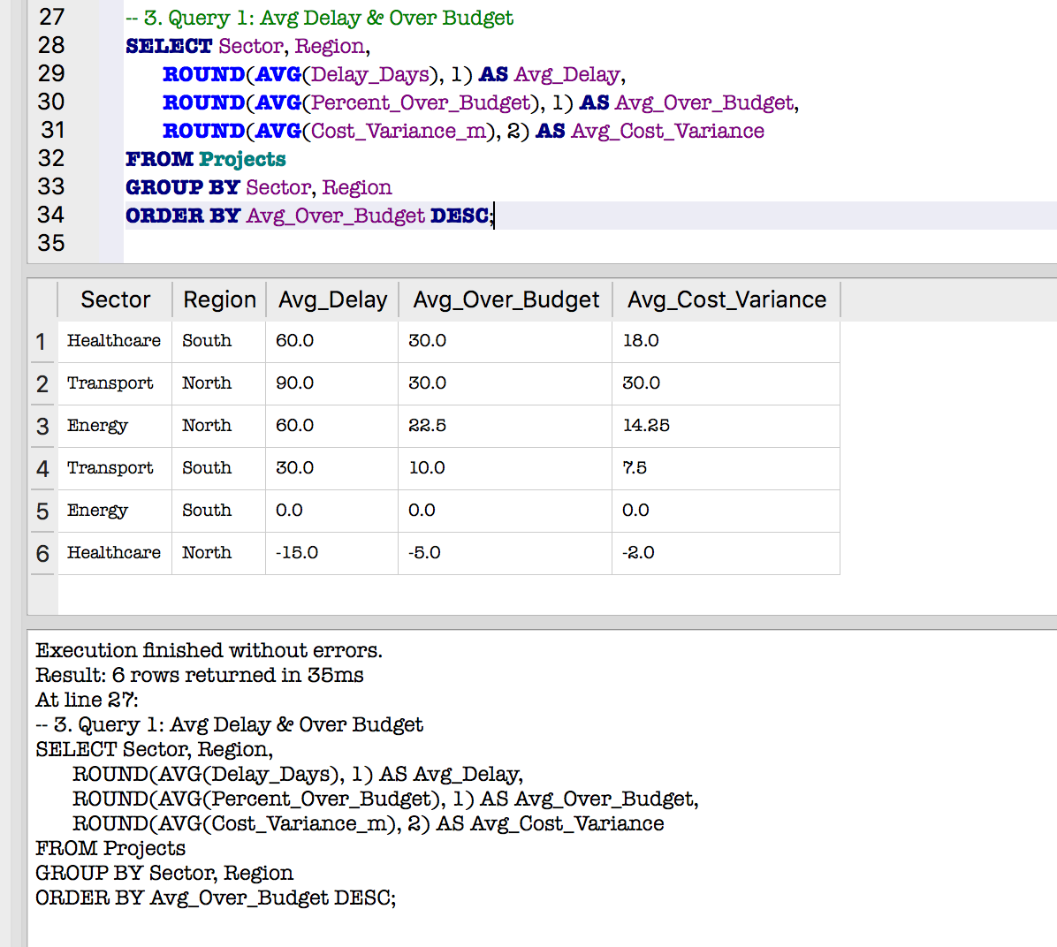


“This query highlights sector- and region-level cost performance, showing where projects are most at risk of overruns. It aligns with the pivot table’s insight that Transport in certain regions, like South, faces significant delays and cost variances.”
“Average percent over budget and cost variance help pinpoint sectors like Energy and Transport for targeted cost optimization interventions.

Slide 5
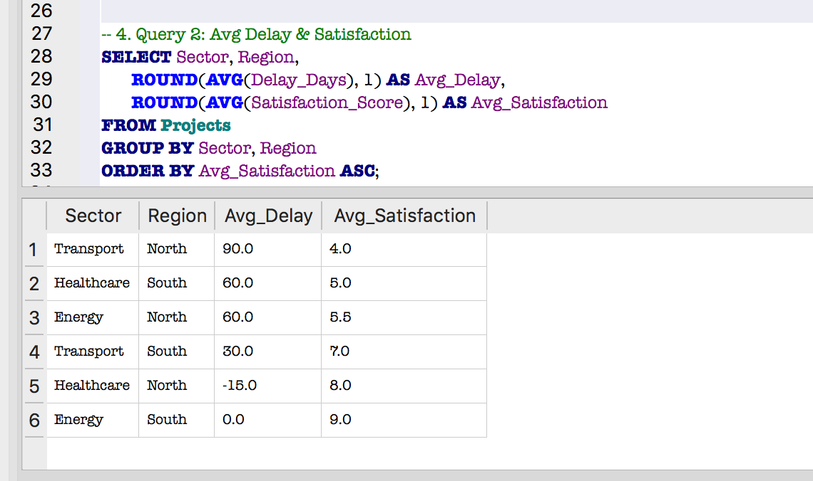
Query 2: Avg Delay & Satisfaction
“This query pairs delays with satisfaction, revealing trade-offs between speed and client happiness. It supports the earlier pivot finding that shorter delays don’t always translate to higher satisfaction, as seen in the South region.”
“Energy projects show higher satisfaction despite varying delays, reinforcing the importance of quality outcomes beyond mere timelines.”

Slide 6
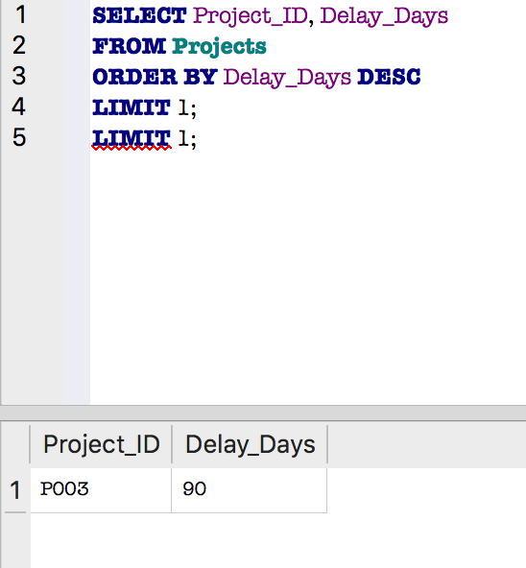
Query 3: Max Delay Project
“Identifying the project with the maximum delay allows targeted analysis for schedule mitigation. This mirrors pivot table findings where the North region had the longest delays (114 days), indicating potential process or resource bottlenecks.”

Slide 7
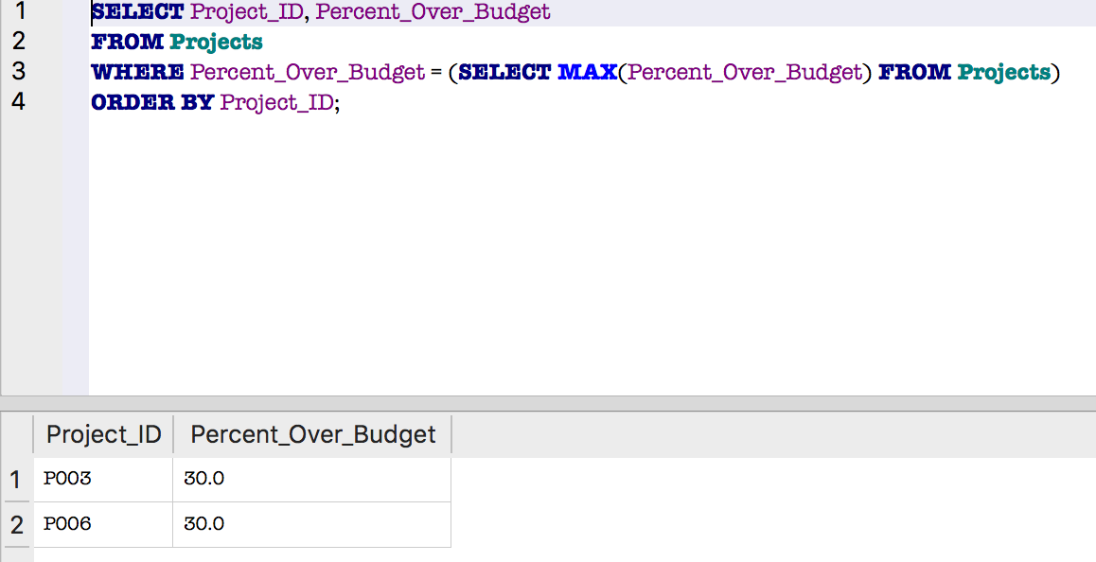
Query 4: Max % Over Budget
“Finding the project with the highest percentage over budget flags extreme outliers, similar to the Wales Transport project with a 613% overrun in the pivot table. These projects need priority attention for risk management and client reporting.”

Slide 8
Transport Infrastructure Cost & Delivery Performance
Mott MacDonald — Wales (2025)
Data-driven analysis of cost variance, delivery delays and stakeholder satisfaction.

Slide 9
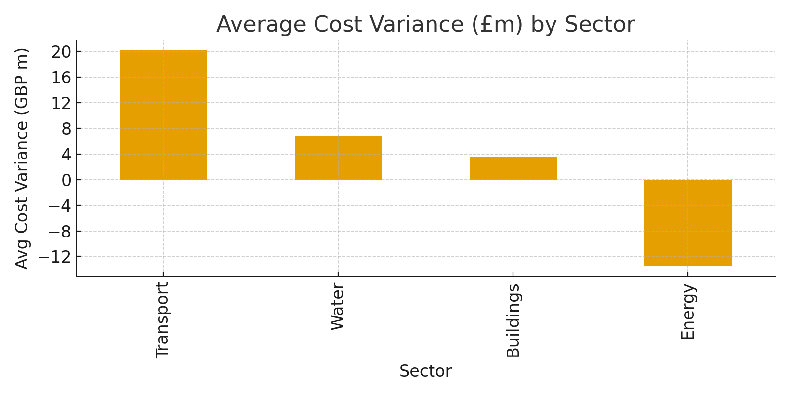
Average Cost Variance by Sector

Slide 10
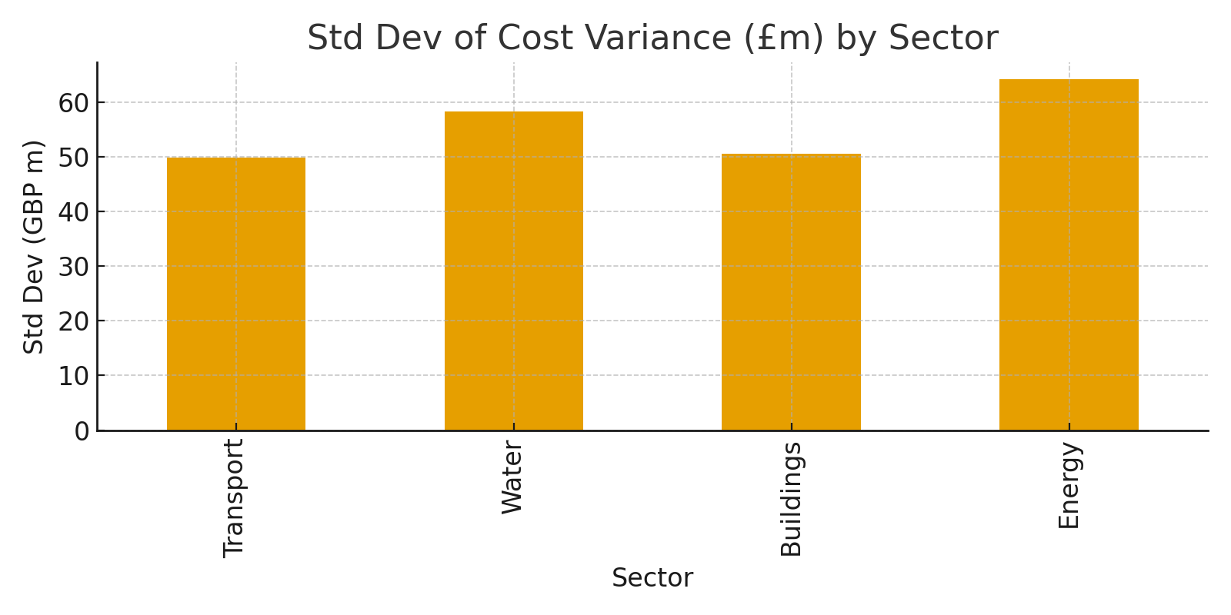
Volatility in Cost Variance by Sector (Std Dev)

Slide 11
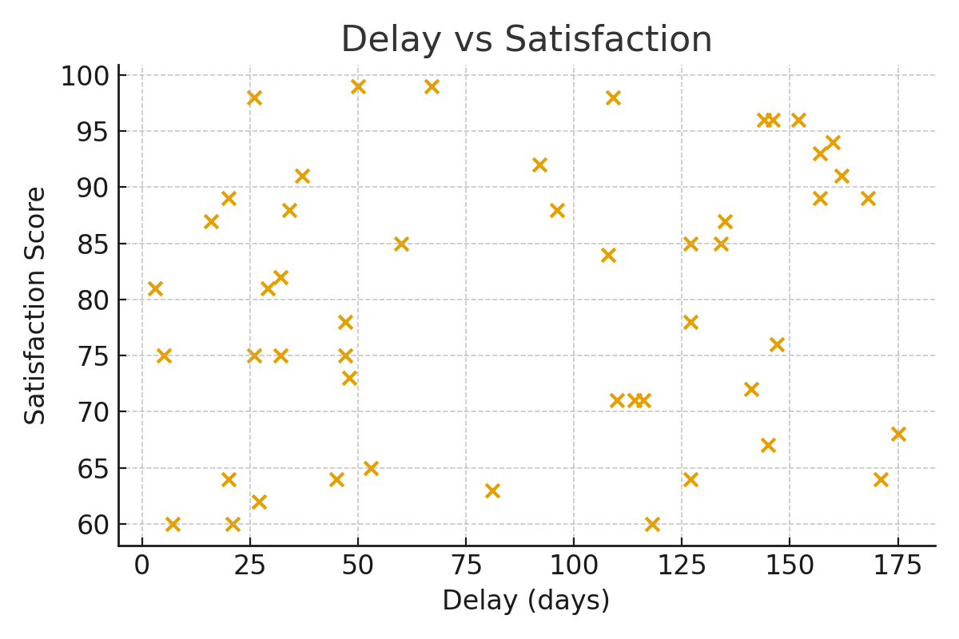
Delay vs Satisfaction

Slide 12
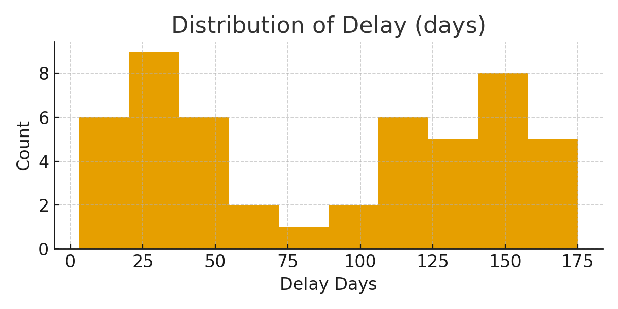
Distribution of Project Delays (days)

Slide 13
Strategic Recommendations for Transport Portfolio Improvement
1. Cost Control & Forecasting
Implement risk-weighted budgeting to account for sector volatility.
Strengthen early-stage cost estimation using historical variance data.
Flag high-risk projects (e.g., Wales Transport) for pre-emptive financial review.
2. Schedule Assurance
Introduce mid-project governance gates to catch slippage early.
Use delay benchmarks (e.g., 90+ days) to trigger escalation protocols.
Prioritize resource reallocation to regions with persistent overruns (e.g., North).
3. Stakeholder Satisfaction
Monitor satisfaction scores continuously, especially on delayed projects.
Identify delay thresholds where satisfaction drops (e.g., ~180 days).
Focus on quality outcomes, not just speed — as seen in Energy sector success.
4. Predictive Analytics & Reporting
Build a dashboard (Power BI) to track cost, delay, and satisfaction in real time.
Use SQL-driven alerts to flag outliers in cost or schedule.
Share monthly insights with leadership for proactive decision-making.

